Slide 1

Assignment Stephen Salve SPJ1139
Topics Covered
Companies - Our Story, Our Vision and Mission.
Executive Summary, Our USP, Target Customers, Presence, SWOT Analysis.
NTCP Diamond Framework Analysis - Rider/Delivery Executive App.
Project Charter.
Result of the Project

Slide 2

Swiggy Story
It all started back in 2014 when two BITS Pilani graduates, Sriharsha Majety and Nandan Reddy decided they wanted to make life easier by changing the way India eats - all with just a tap! With their idea of ’hyperlocal food delivery’,
Later they met Rahul Jaimini, who brought this vision to life with the first website. And with this, Swiggy was launched as a food ordering & delivery platform. Swiggy's Story.
Our mission is to change the way India eats apart from servicing the customer better than last year and widening the assortment to enable users to order on a higher frequency. Swiggy wants to be like a utility app for every Indian. We want people to order food at least 15-20 times a month. That can only happen if you solve deep problems and not just act as an occasional food delivery provider. For us, it is about how we balance growth and customer service in the long run.
"Swiggy's vision is to elevate the quality of life of consumers by offering unparalleled convenience. As we work towards enabling this for a billion Indians, expanding to tier-3 and tier-4 cities is a critical step.

Slide 3

Executive Summary
Swiggy is food ordering and delivering company.
A single window for ordering from a wide range of restaurants.
Exclusive fleet of delivery personnel to pick up orders from restaurants and deliver its customers.
Our USP
No minimum Order Value.
Live Tracking.
Lighting-fast-delivery.
Target Customers
18-55 years old College Students.
Working Professionals.
E-Commerce Savvy.
Crowd that is living away from their hometown.
Presence
Ahmedabad, Bangalore, Chennai, Delhi, Gurgaon, Hyderabad, Kolkata, Mumbai, Pune and 527 more cities

Slide 4
SWOT Analysis - Swiggy
S.W.O.T. is an acronym that stands for Strengths, Weaknesses, Opportunities, and Threats. A SWOT analysis is an organized list of your business’s greatest strengths, weaknesses, opportunities, and threats.
Strengths and weaknesses are internal to the company (think: reputation, patents, location). You can change them over time but not without some work. Opportunities and threats are external (think: suppliers, competitors, prices)—they are out there in the market, happening whether you like it or not. You can’t change them.
Existing businesses can use a SWOT analysis, at any time, to assess a changing environment and respond proactively. In fact, I recommend conducting a strategy review meeting at least once a year that begins with a SWOT analysis.
New businesses should use a SWOT analysis as a part of their planning process. There is no “one size fits all” plan for your business, and thinking about your new business in terms of its unique “SWOTs” will put you on the right track right away, and save you from a lot of headaches later on.

Slide 5









Fast Delivery: Swiggy is always known for it. It has always taken care of their customers by delivering their order in time.
Sensible complete Image: We think of ordering food the First Name which click is Swiggy. It has developed clean and crystal image among people.
Trained folks for creating Delivery: Swiggy has well trained their team to March in the market.
Wide selection of eating place Offered: The main USP Point of Swiggy is that they provide eating options from various places and wide ranges.
Neat Packaging: Swiggy delivers the food with neat and hygienic packaging.
Orders solely on the market from the restaurants that are within the zone of the order placed. : Swiggy is targeting on the zonal restaurants. As their competitors are increasing they need to expand their restaurant.
Premium restaurant are not present on them which can increase their Average Order value.
AOV-(Average Order Value) of order is between 200 to 250.
W
S
Pioneer in Food Delivery Business: Swiggy was the first Platform to introduce this concept in the Market. They have shown a new way to Home –Delivery with minimal charges.
Growing marketplace for Potential Customers. They have shown People to rise and grow in the market.
Increase in Market Share
Value Effective and sensible Quality Food.: They need to increase their Zonal Restaurant Base to compete in Market.
Give higher Service: Delivery should be more quick and no charges.
T
Increasing Health consciousness.
Increasing potential competitors.
Negligence of potential competitors.
O

Slide 6
NTCP Diamond Framework Analysis (Rider/Delivery Executive App)
Novelty – Similar app have been built by amazon and big logistic companies. This was more for hyperlocal business. The way and features build had some uniqueness but not original.
Technology – From technology perspective this project is categorized as high tech because of the complexity and new technology used to help Customer see all the accurate ETA. Monitor the Rider, Track the rider.
Complexity - This App is build with lot of complex component as this is the actual source which help us show restaurants, ETA and various section on the Customer App.
Pace – Will the right resource the time factore is eliminated and take care off. Microservice architecture helps us solve the time critical section..

Slide 7


Slide 8
Project Charter
Business Case
The Restaurant Listing and Delivery Time Promised.
When a customer opens the app, the first call is made to the Delivery system to figure out:
1.The restaurants that are actually serviceable to the customer, which means those from which a delivery is possible within some stipulated time (say, at most 60 minutes).
2.The expected delivery time of an order from a potential restaurant.
Estimating Last Mile Time
Last Mile is the time taken by the Delivery Executive from the Restaurant to the Customer’s location.
Estimating Preparation Time
Another big chunk of the Delivery Time is the time a restaurant takes to prepare the food. Estimating Preparation Time when the customer first opens the app is a really tricky concept, given that we don’t even know what or how much they might potentially order!
Just In Time Assignment (JIT)
As soon as an order is placed, two wheels are set into motion: on one side, the restaurant starts preparing an order and on the other side, the system searches for nearby Delivery Executives and assigns them so they can head to the restaurant and pick up the order.
.
Notes:
Business Case : <This paragraph should talk about the purpose of this project, including the business problem it is aiming to solve. What the business is going to achieve and the benefits. The justification for the project should be provided here. >

Slide 9
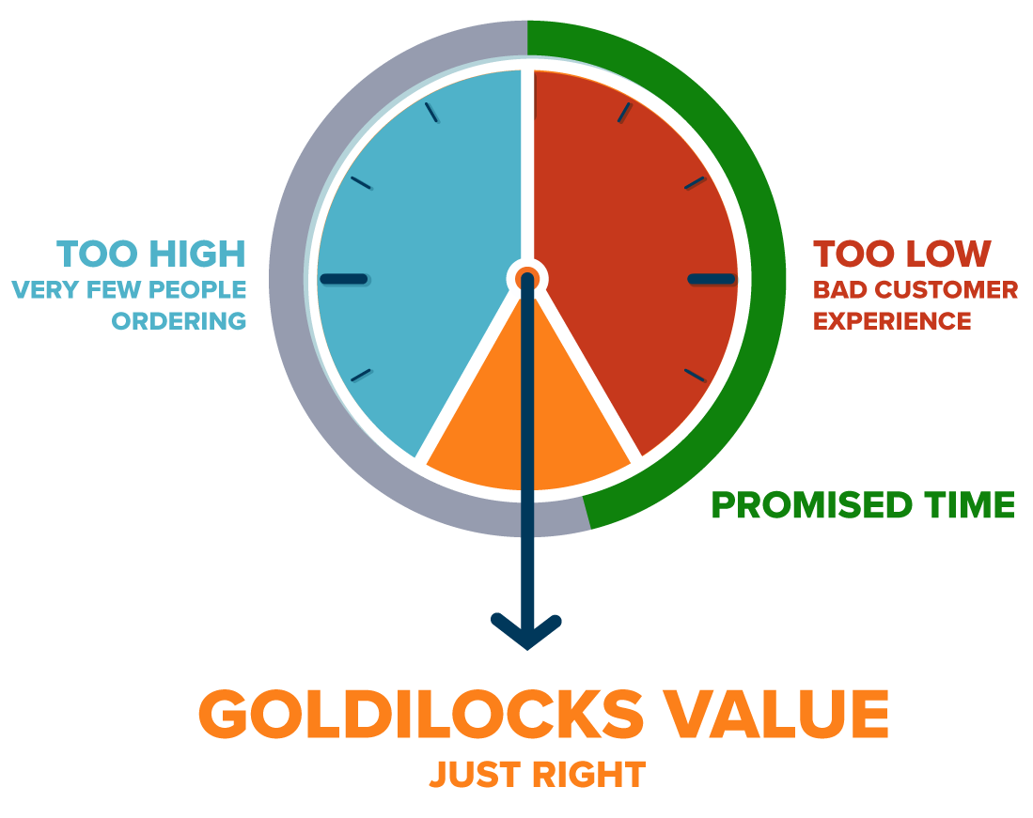
Project Charter
Project Objectives
It’s about finding just the right time to ensure delivery, but not too high to discourage the customer from placing an order.
It’s also about providing ample choice of restaurants to the customer, but just enough so we can calculate their delivery times as quickly as possible.
Everything in Delivery is about finding the Goldilocks value.
Notes:
<This should outline objectives of the project. High level business needs expected to be addressed by the project are to be outlined. USE SMART>

Slide 10
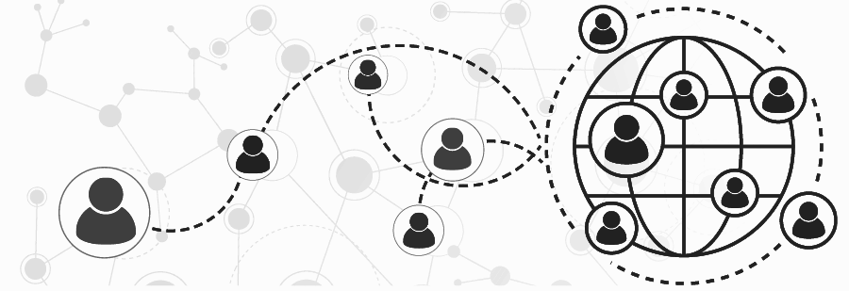
Project Charter
Key Stakeholders
Backend Developer.
Devops Team
Data science team.
Legal Department.
Restaurant Partners.
Delivery Executive.
Operational Department/Team.
Finance Department.
Back office.
Customer App
Frontend Developer.

Slide 11
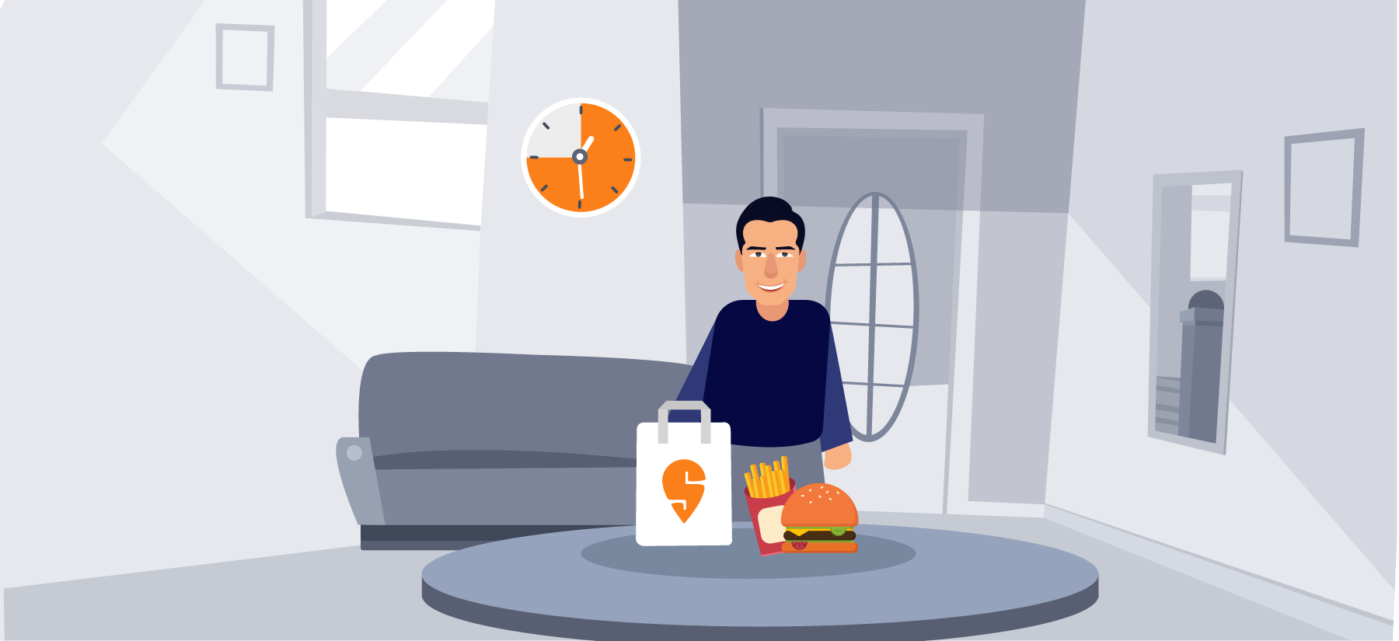
Project Charter
Project Success Criteria
95% of the rating should be 5/4 Star for the Orders Delivered.
Rider App should have 90% accurate in the terms of the location data.
Rider App should have 5X load capacity to no of orders placed. No of order to growth week on week.
99% uptime of the Rider app.
Crash-Free Users and Crash-Free Sessions should be 99%
Crashes per week should not be more than 50.
Notes:
Project Success Criteria
<This paragraph should outline those aspects of the project that determine its success. This may include objective (“website should serve 1million users per month with page load time of under 2 seconds”) as well as subjective criteria (“webpage design should be pleasing to the customers”).>

Slide 12
Project Charter
High-level Requirements
The Restaurant Listing and Delivery Time Promised should be 95% accurate.
Estimating Last Mile Time should cover the parking time to customers location.
Estimating Preparation Time should consider food item and its quality as well.
Just In Time Assignment (JIT) that helps customer place orders for any the vendors shown to him.
Notes:
High-level Requirements
<This section should list only high level requirements, mostly bulleted points. This should be starting point for the process of requirements collection effort.>
Business and Technical Requirements if any

Slide 13

Project Charter
Project Risks
Over Engineering.
Difficult in maintain such complex system.
Risk of Over Budget.
App being the bottle neck for real time data.
Single point Failure.
Over consuming device battery.
Feature compatibility with the riders Device.
Notes:
Project Risks
<This section should talk about identified risks for the project. These can be external or internal to the project. Risks may also about time-to-market, initiating from competition, regulations compliance from government or industry. If any of risk mitigation strategies are understood, they need to be mentioned as well.>

Slide 14

Project Charter
Major Milestones -
Milestone | Task | Date
Milestone 1 | The Restaurant Listing and Delivery Time Promised should be 95% accurate. 90 Day | 30th Jan
Milestone 2 | Estimating Last Mile Time should cover the parking time to customers location. 60 Day | 5th March
Milestone 3 | Estimating Preparation Time should consider food item and its quality as well. 20 Days | 15 th March
Milestone 4 | Just In Time Assignment (JIT) that helps customer place orders for any the vendors shown to him. 35 days | 10th April
Notes:
Major Milestones
<Major milestones include ‘what is expected’ and by ‘when’. For an ecommerce web-site this could be the order and timelines for each of the modules (login, user-registration, role management, product details, shopping cart, logout, security, performance etc> to be delivered.>

Slide 15

Project Charter
Summary Budget
Budget | Task
60 lakhs per annum | The Restaurant Listing and Delivery Time Promised should be 95% accurate.
30 lakhs per annum | Estimating Last Mile Time should cover the parking time to customers location.
30 lakhs per annum | Estimating Preparation Time should consider food item and its quality as well.
50 lakhs per annum | Just In Time Assignment (JIT) that helps customer place orders for any the vendors shown to him.
Notes:
Summary Budget
<This is crucial aspect of Project Charter. Many a times project comes to unexpected halt due to lack of funding. Planning the project scope based on budget will ensure that high-business-value features are done up-front giving most Return on Investment.>

Slide 16

Project Charter
High-level Assumptions, Dependencies and Constraints
Assumptions :
Assumption | Impact | Strategy
Full network to the Rider all the time. | Order reaching Customer late | Tradition Simulation
App experience would fit for all types of Riders. | Mistakes that could end up in delay | Training for Rider
Real time updated via the app without any delay. | Real time tracking | Back to displaying only ETA.
Notes:
High-level Assumptions, Dependencies and Constraints
<Any high level assumptions, constraints arising from government regulations, or otherwise, etc are to be outlined here.
And dependencies on the project, resources, funding etc – which will impact project are also outlined.>

Slide 17

Project Charter
High-level Assumptions, Dependencies and Constraints
Dependencies :
Dependencies | Impact | Strategy
Mobile Network. | Calling Feature | Chat Options
Mobile Internet. | Rider Pings | Traditional ETA Method
Infra that Support the End to End feature | Riders not getting Order | DR plan in place
Notes:
High-level Assumptions, Dependencies and Constraints
<Any high level assumptions, constraints arising from government regulations, or otherwise, etc are to be outlined here.
And dependencies on the project, resources, funding etc – which will impact project are also outlined.>

Slide 18

Project Charter
High-level Assumptions, Dependencies and Constraints
Constraints :
Dependencies | Impact | Strategy
Time to Release the app for riders. | Revenue / Customer Satisfactions | Work with the older version
Notes:
High-level Assumptions, Dependencies and Constraints
<Any high level assumptions, constraints arising from government regulations, or otherwise, etc are to be outlined here.
And dependencies on the project, resources, funding etc – which will impact project are also outlined.>

Slide 19
Project Charter
Core Team and Organizational Structure
Assigned Project Manager :
Ram is assigned as the project manager for managing the project. He has been authorized to pull different resources from various department to meet the targeted timeline.
All the HOD has been Updated with the Business Case, Project Objectives and Project Success Criteria. They have been addressed to provide full support the PM in terms for achieving the Targeted timeline.
Notes:
Assigned Project Manager
<Project manager is identified and assigned when this document is prepared. This section will also talk about the authorization and responsibilities given to the project manager. These will basically vary based on whether the organization is that of functional, matrixed, or Projectized.>

Slide 20

Project Charter
Core Team :
Name | Function | Role | Need*
Ramcha | Product | Scoping all the required feature for the Ride app. | The product manager is the person responsible for defining the why, when, and what of the product that the engineering team builds. This means they lead cross-functional teams from a product's conception all the way through to its launch.
Niranja | Data Science | Data-driven decision | Data has always been vital to any kind of decision making. Today’s world runs completely on data and none of today’s organizations would survive without data-driven decision making and strategic plans.
Prakash | Head of Eng | Coding | Develop various components in the Rider App, LMS, API’s, various services.
Surya | Head of QA | Quality assurance | QA is a way of preventing mistakes and defects in the products and avoiding problems when delivering products to the Riders
Mayank | Head of Operation | LMS feature | To check that all the features in the LMS are up to the mark for smooth Operation.
Notes:
Core Team
<Core team required to kick-start the project, and team ramp up expected – are mentioned in this section. Core team members identified at this juncture are mentioned as well.>*Need – indicates person-month (or whichever measurement unit is used) that this role is needed on the project. Expensive roles such as Architect are needed in full capacity at the beginning of the project, and in partial capacity at the later point. Such needs are mentioned here.

Slide 21

Project Charter
Project Sponsor :
Name | Designation | Role*
Vivek Sunder | Chief Operating Officer | Business Case Challenges.
Mayank | Operational Head | Reduction in Cost Per Delivery by 30%
Notes:
Project Sponsor
<Project sponsor, their designation, role and contact details are mentioned in this section.>

Slide 22
Result of the Project
Notes:
Project Sponsor
<Project sponsor, their designation, role and contact details are mentioned in this section.>

Slide 23
Result of the Project
Notes:
Project Sponsor
<Project sponsor, their designation, role and contact details are mentioned in this section.>

Slide 24
Result of the Project
Notes:
Project Sponsor
<Project sponsor, their designation, role and contact details are mentioned in this section.>

